Slide 1


ArchiMate Modeling using Archi® Tool
00
Opening and Introduction
Based on Sparx Systems’ ArchiMate Introduction

Slide 2
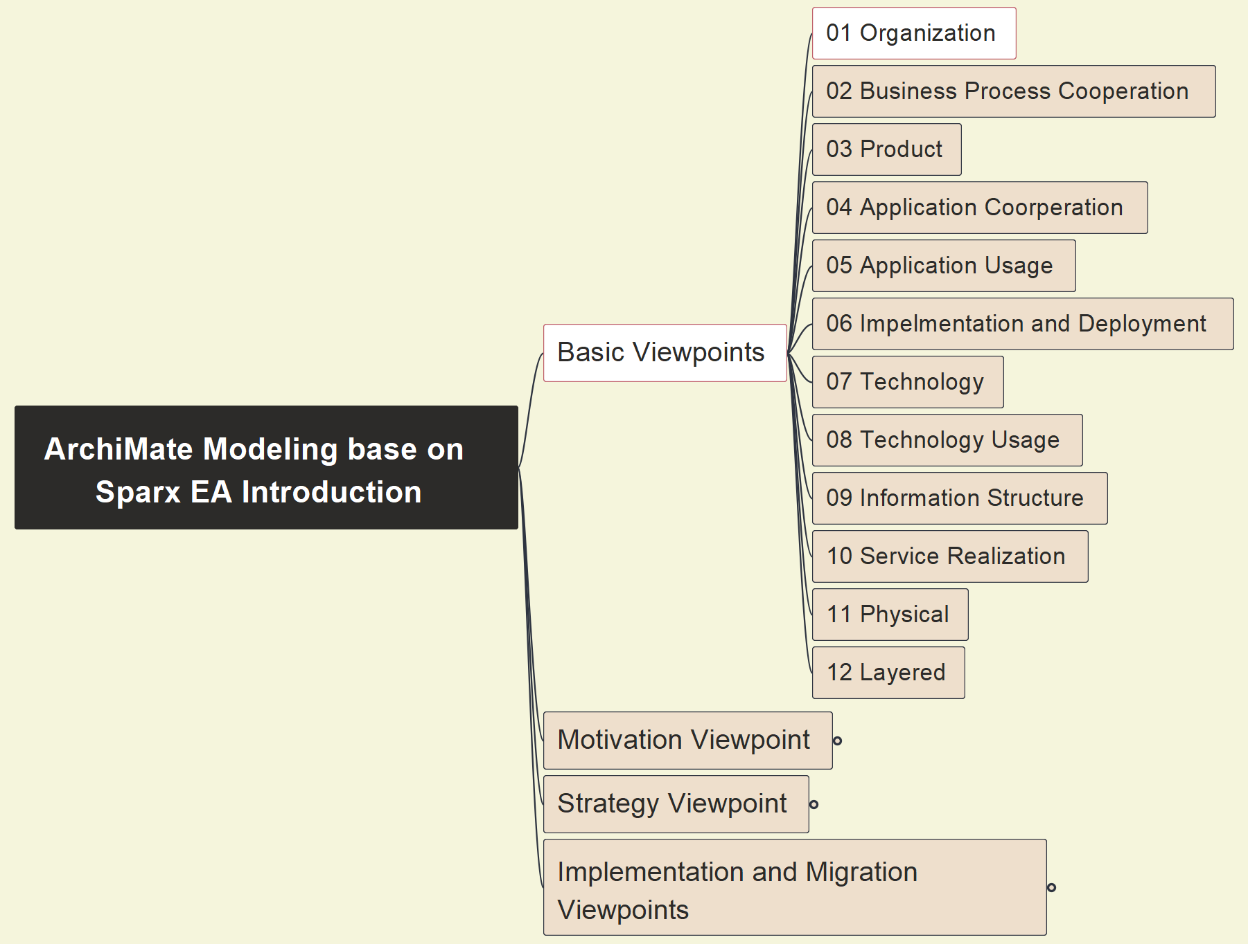
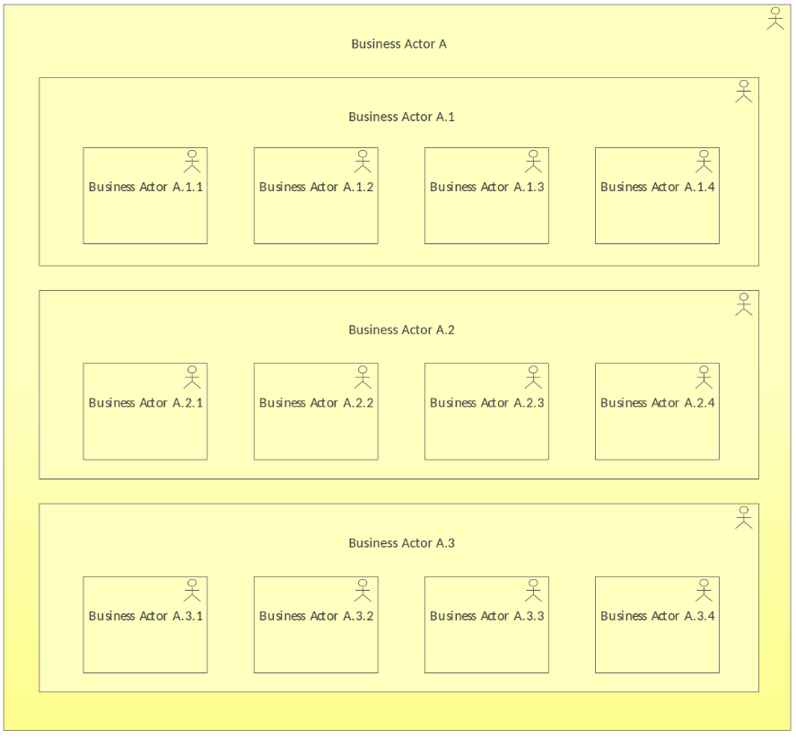
01 Organization - Pattern
01
ArchiMate-Modeling-Tutorial_00_Opening-and-Introduction

Slide 3
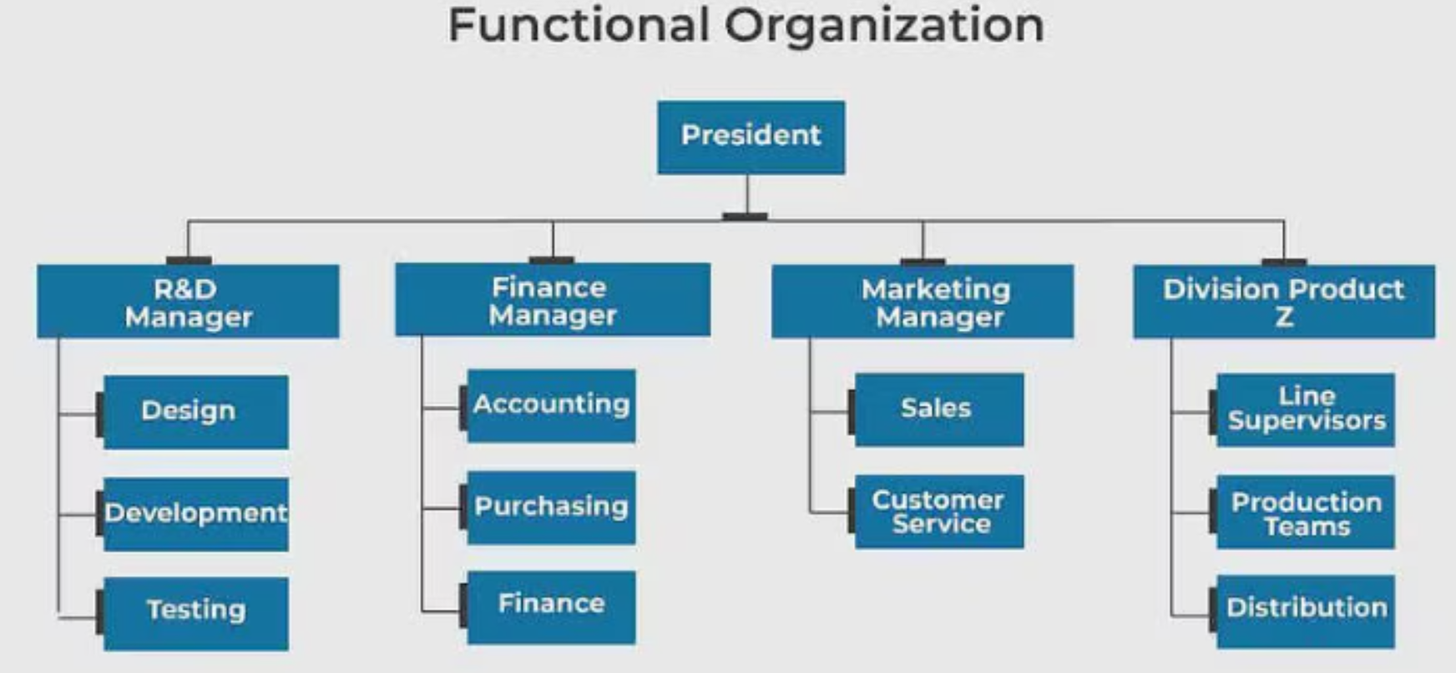
01 Organization - Example
02

